Slide 1



Category For Idea Submission:
Autonomous vehicles for different road and traffic conditions (e.g. city, highway, off-road)
Project title:
Pothole Detection System
Team Name:
Sapphire
Team Member names along with Project Guide/mentor:
Project Members
Mentor
YOGESH T N - Leader
SUGUNA S - Member
THARUNIGA M - Member
Mr. R.P.KARTHIK
Assistant professor,
Electronic and communication engineering,
Kongu engineering college
1

Slide 2


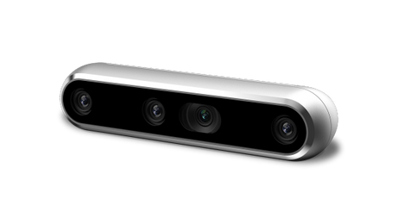
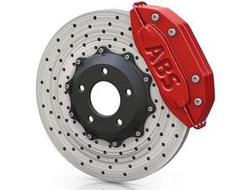

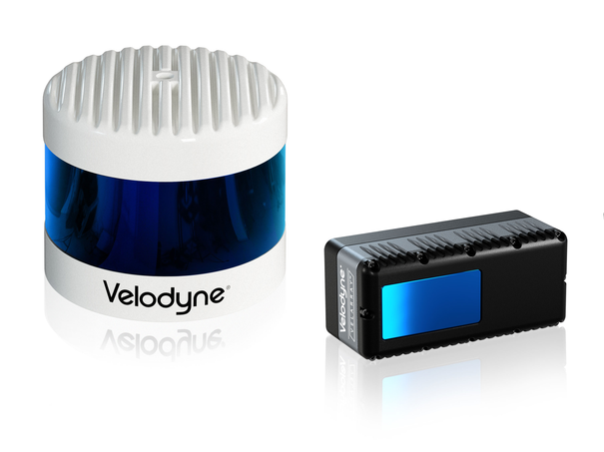
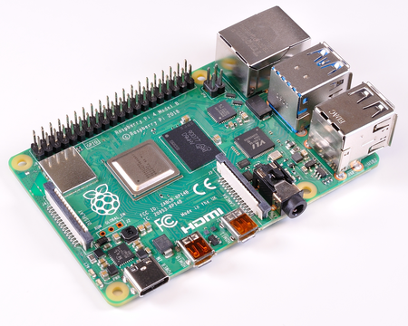
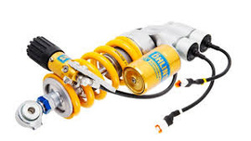
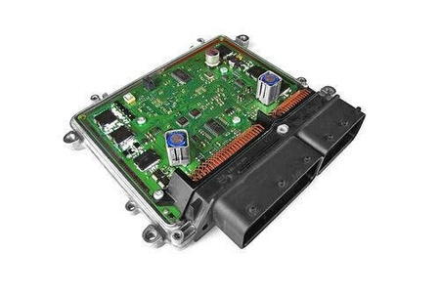
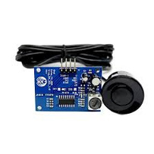
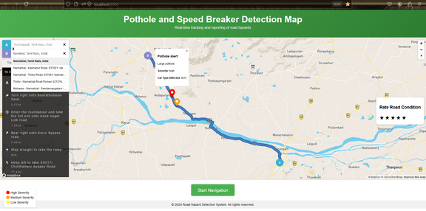



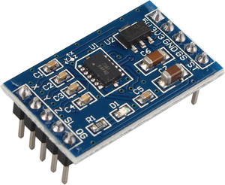
Innovation:
EdgeAI Hardware & Software-based detection of road conditions such as potholes, speed breakers, rough conditions, and dynamic vehicle stability management and alert system
Intel real sense camera (D435i)
+
ABIP
Braking System
LiDAR sensor
Embedded graphics computing module: Processing the inputs and sending decision to the ECU
ECU: Controlling the suspension and brakes based on decision
Feedback
CAN/OBD
DSCP
Feedback
Electrically controllable suspension
DACP
Ultrasonic
+
+
Accelerometer
SkyLab GPS
Database
Navigation web with data of potholes on the roads
Alert my car
Damaged road
2

Slide 3


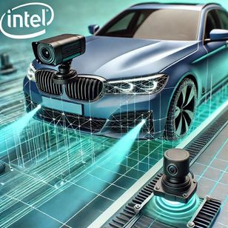


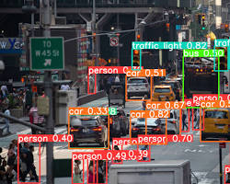
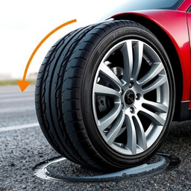
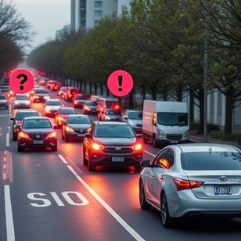
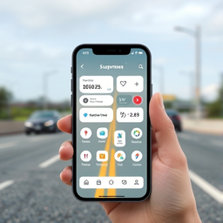
Key Differentiators:
Cost and Safety Benefits:Reduces repair costs, enhances safety, and facilitates better road maintenance.
Multi-Sensor Fusion:
Combines RealSense camera, ultrasonic, and LiDAR sensors for precise pothole detection
AI-Powered road
Image Recognition:
Real-time, accurate pothole detection using Ai
Real-Time Alerts:
Immediate notifications on potholes to prevent accidents and vehicle damage
Road Quality Rating:
Scale from 1 to 5 based on potholes, speedbrakes, and vibrations for road assessment.
Tyre and Suspension Self-Life: Reduces wear by alerting about potholes early.
Scalable Solution:
Alerts vehicles within a 500m radius and shares data via a web platform(optional).
Interactive Mobile App:Integrates suspension controls, pothole alerts, and road ratings in one app.
3

Slide 4
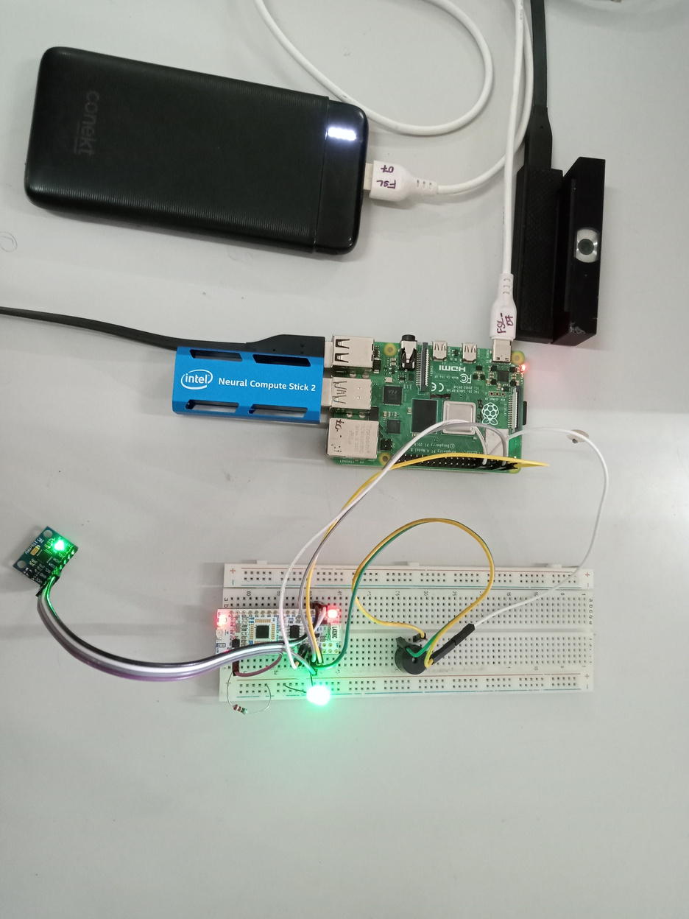
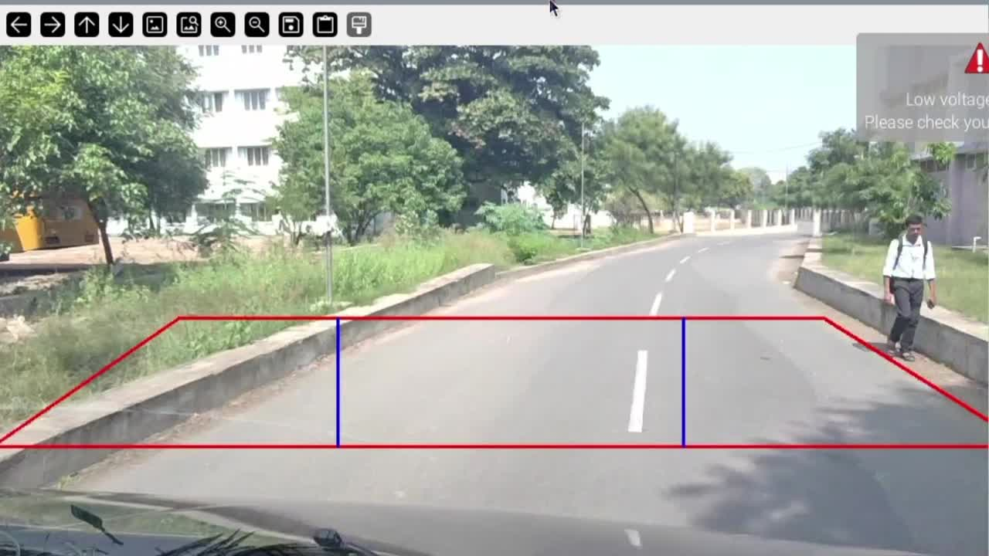
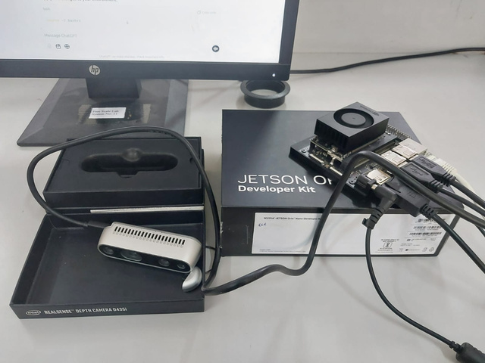
Prototype:
For the progress we are working on the development of the Ai model(Yolov8n) to detect the potholes from the camera input .
The model is now capable of detecting the potholes from the input video and alert the users by means of alarm sound.
Prototype 1: Testing with Raspberry pi
Prototype 2: Testing with Nvidia Jetson Orin Nano
4

Slide 5


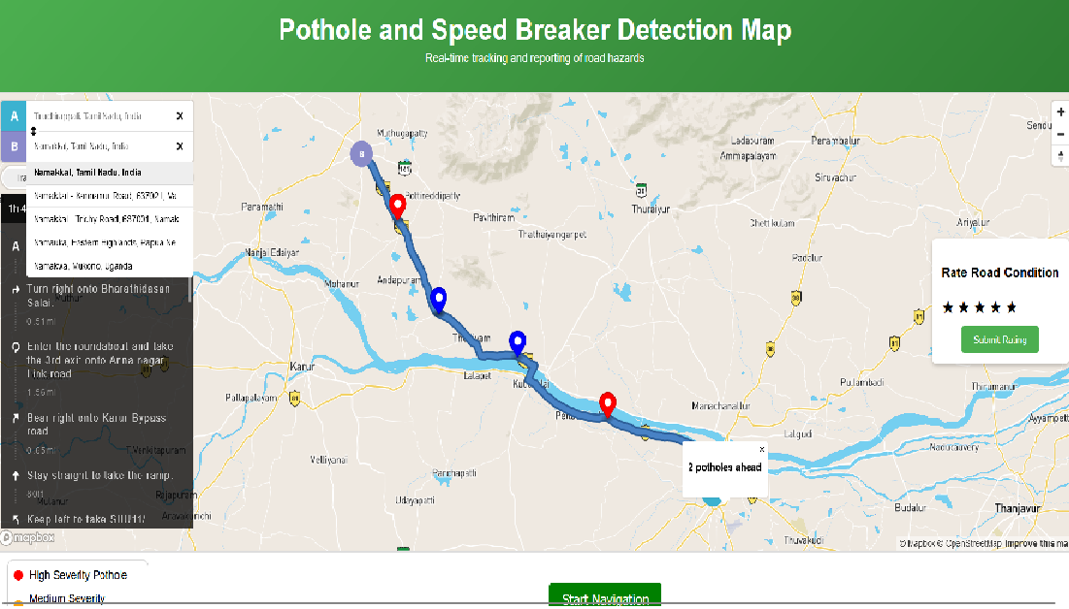
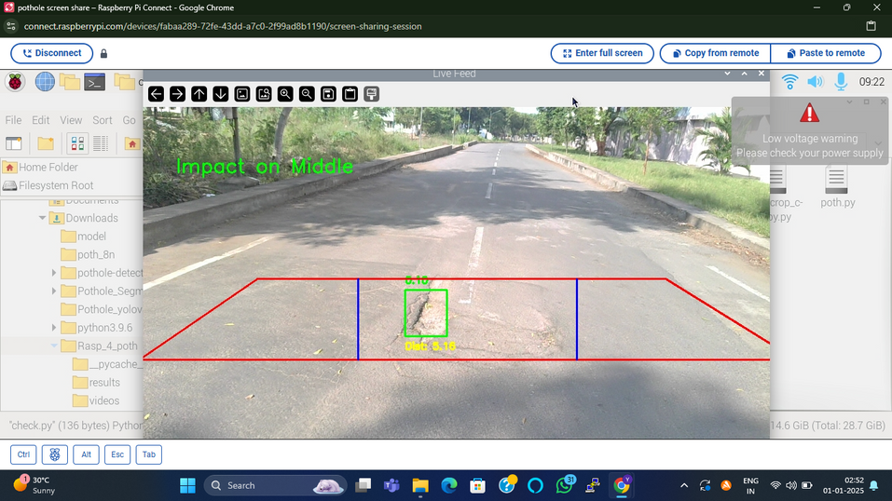
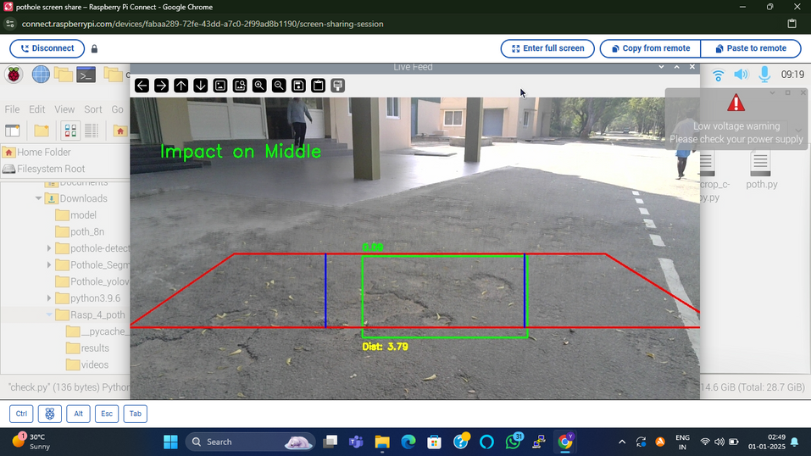
Proof of concept
Website navigation:
Roadsense → Backend → MongoDB → Backend → Map Application
Drive for more: https://drive.google.com/drive/folders/1ZO2W5SU9rXqz60oVjw1j9nPr8mUvlgQ8
(Our device)
Desktop view
Live pothole marking
5

Slide 6
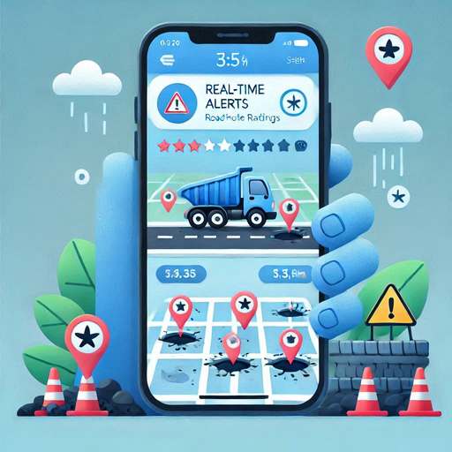


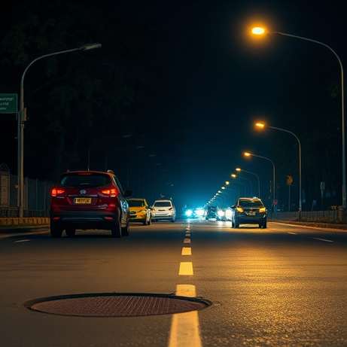
Future Plans/potential next steps
1.Interactive Mobile Application
3.Enhanced Road Quality Rating
2.Suspension Controls Integration
4.Enhancing Road Condition Database for India
6

Slide 7
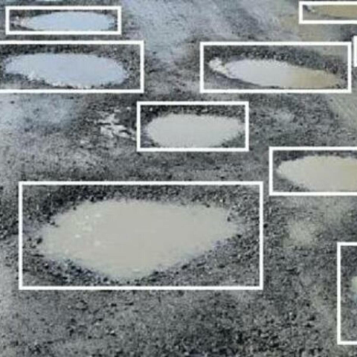
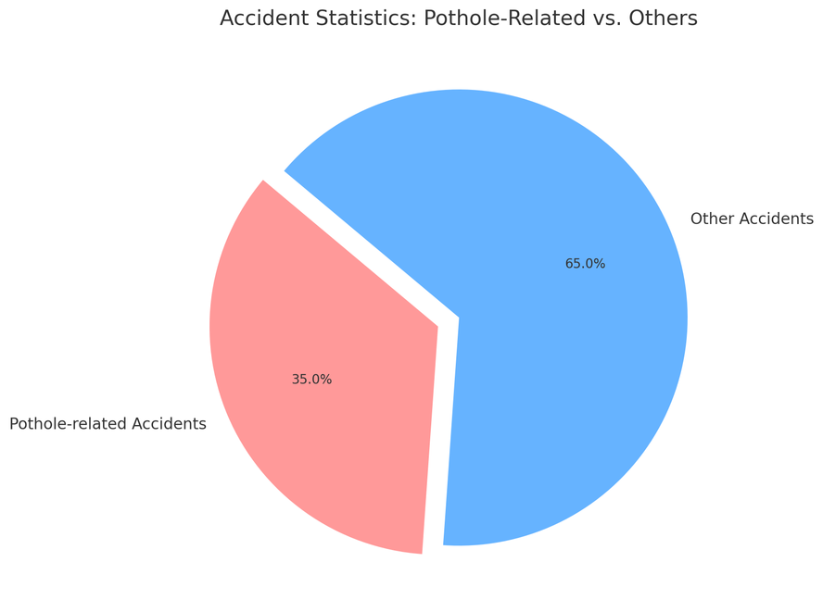
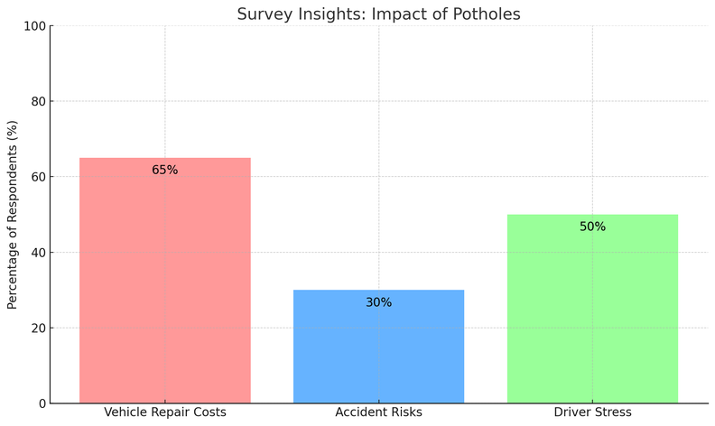
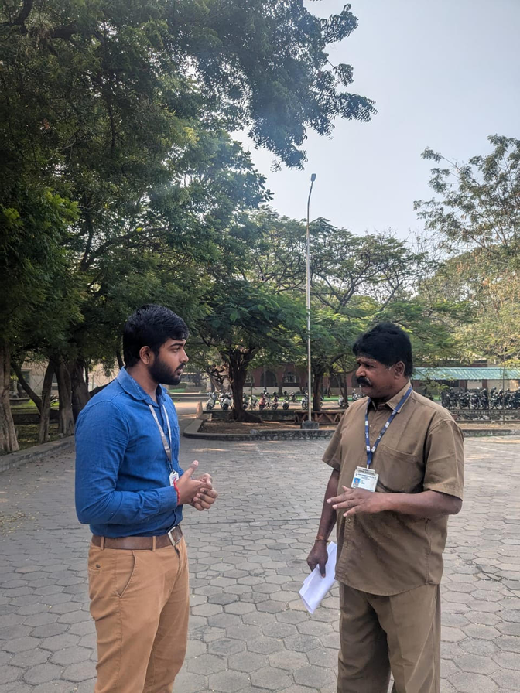
Technical Details and Reports
Dataset: Collected and annotated 2000 pothole images using YOLOv8
Accident statistics:
pothole related vs others
Survey Insights : Impact of Potholes
HARDWARE DEPOLYMENT:
FIELD SURVEY:
We have used Raspberry pi 4 along with Intel NCS2 for computing.
Now we are working with Jetson Orin Nano and Intel Depth Camera
We are working on the part of mitigation system control using CAN bus interface.
We conducted a field survey among the drivers in our institution.
The drivers encouraged the idea and provided affirmation that our system will be helpful.
We obtained valuable insights from them for our system.
7

Slide 8

Thank you
sparkle.kpit.com
8

